Slide 1

From Words to Wisdom
An NLP Demo: From Neural Networks to Transformers

Slide 2
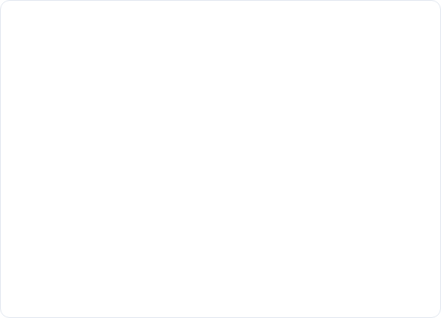
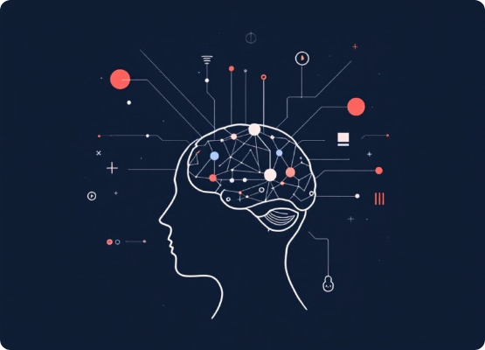
What is Natural Language Processing?
The quest to teach computers to understand, process, and generate human language.
It's the science behind...
•
Chatbots and Virtual Assistants
•
Sentiment Analysis (Reading Reviews)
•
Machine Translation (Google Translate)
•
Summarization and Q&A

Slide 3

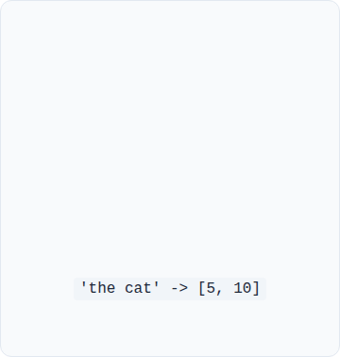
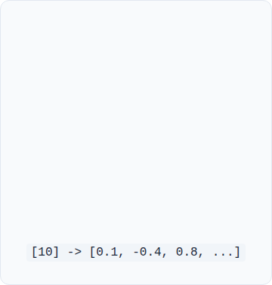



The Absolute Basics: Key Terms
Corpus
Tokenization
Embeddings
The entire collection of text data we use for training (e.g., our 'Alice in Wonderland' text).
Breaking text into pieces (tokens). This is the first step for our demo's SimpleTokenizer.
A vector of numbers that represents the 'meaning' of a token. This is what the model learns.

Slide 4
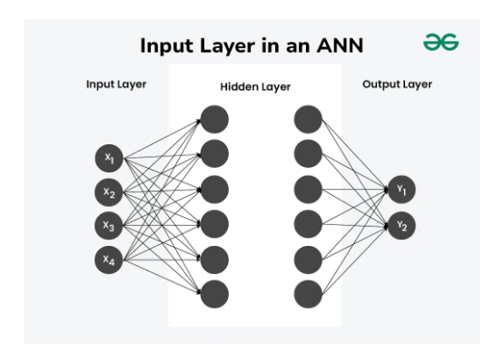
What is a Neural Network?
A "brain" inspired by biology, designed to learn patterns from data.
It's made of layers of simple "neurons":
•
Input Layer: Takes in the data (e.g., our token embeddings).
•
Hidden Layers: The "thinking" part where patterns are found.
•
Output Layer: Produces the final answer (e.g., the next predicted word).

Slide 5
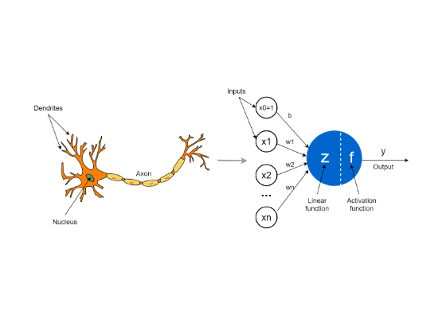
The Smallest Piece: A "Neuron"
A single "neuron" is just a simple calculator.
It performs 4 basic steps:
1.
Takes in multiple inputs.
2.
Multiplies each input by a "weight" (its importance).
3.
Sums them all up.
4.
Passes the total through an Activation Function.

Slide 6
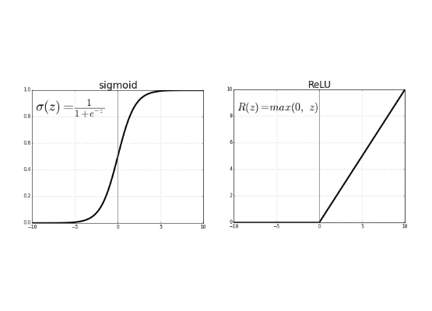
The "Dimmer Switch": Activation Functions
The activation function decides if a neuron "fires" and how strongly.
•
It's a "non-linear" function that acts as a gate or a dimmer switch.
•
Without it, the entire network would just be one giant, simple equation and couldn't learn complex patterns.
•
ReLU (Rectified Linear Unit) is the most common: "If the signal is negative, output 0. Otherwise, output the signal."

Slide 7
How Do Neural Networks Learn?
1. Make a Guess: The model processes an input (e.g., 'alice followed...') and guesses the next word.
2. Measure Error (Loss): A Loss Function (like nn.CrossEntropyLoss) calculates how "wrong" the guess was.
3. Find Blame (Backpropagation): The error is sent *backward* through the network to find which weights contributed most to the mistake.
4. Update Weights (Optimization): An Optimizer (like optim.Adam) slightly adjusts all the weights to make a better guess next time.

Slide 8
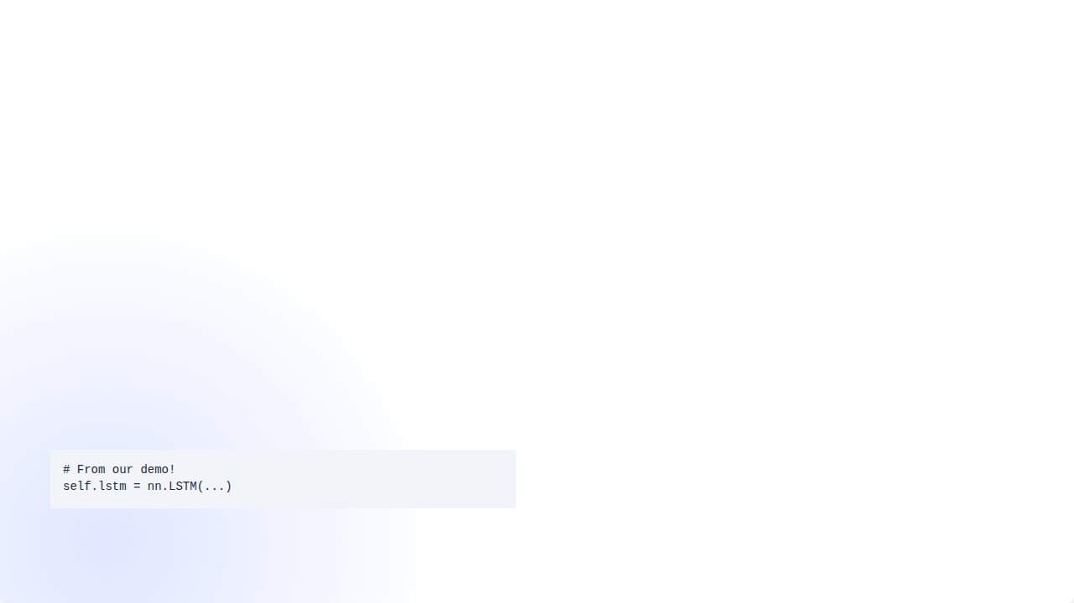
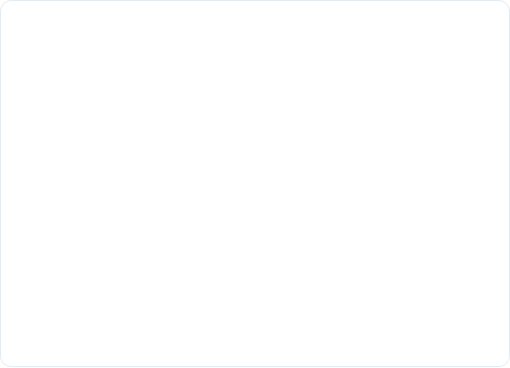
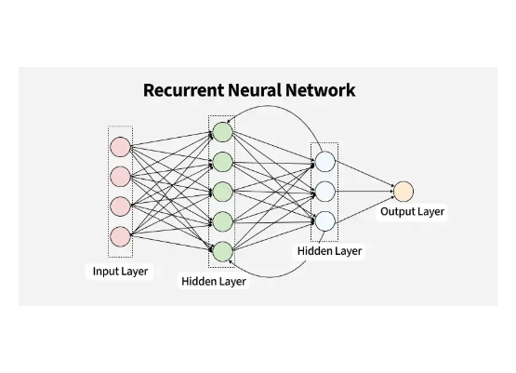
The Old Problem: Memory
Basic NNs have no memory. RNNs (Recurrent) and LSTMs were the solution.
•
They process sequences step-by-step, passing a "memory" (or hidden state) from one word to the next.
•
This is what our ToyLLM uses!
•
Problem: They are slow (can't process words in parallel) and can "forget" context from the distant past.

Slide 9
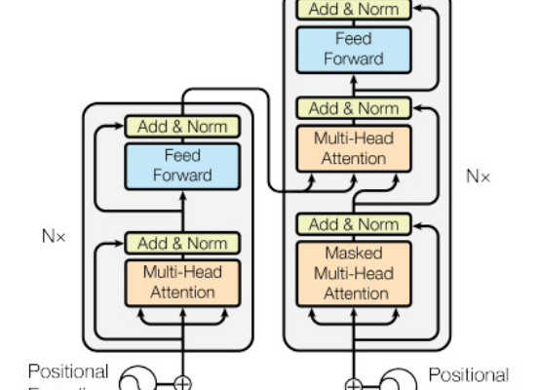
A Better Brain: The Transformer
The 2017 paper "Attention Is All You Need" changed everything.
•
It introduced the Transformer architecture, which has no RNNs or LSTMs.
•
It can process all words in a sentence *at the same time* (parallelizable).
•
It uses a new mechanism called Self-Attention to find context.

Slide 10






The Secret Sauce: Self-Attention
What is it?
Example
Benefit
A mechanism that lets the model weigh the importance of *every other word* in the sentence when processing a single word.
When processing 'it' in "The rabbit ate the carrot because it was hungry," attention helps the model know 'it' refers to the 'rabbit', not the 'carrot'.
It provides deep, flexible contextual understanding and is much faster to train than RNNs.

Slide 11
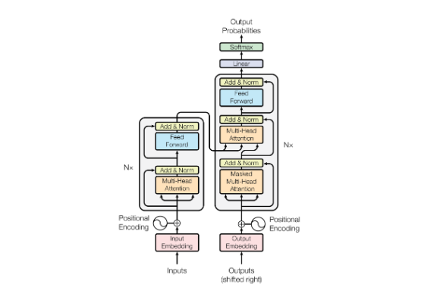
High-Level Transformer Architecture
Most transformers are "Encoder-Decoder" models.
•
The Encoder "reads" and understands the input (e.g., an English sentence).
•
The Decoder "writes" and generates the output (e.g., the French translation).
•
GPT-style models (like ChatGPT) are "Decoder-only" models, which makes them excellent at generation.

Slide 12
Our Demo: A 3-Phase Journey
How we build a modern LLM (like our ToyLLM)

Slide 13
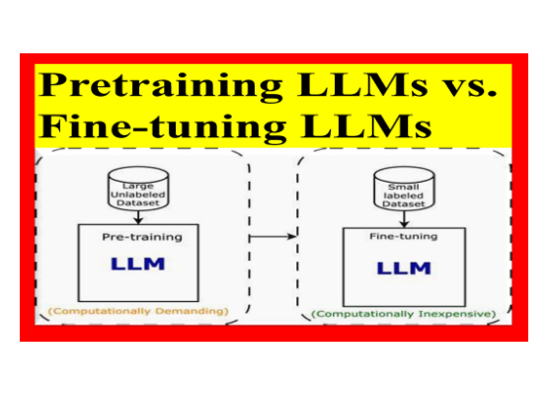
Phase 1: Foundational Pre-training
Goal: Learn Language & Facts
•
Method: Next-Word Prediction.
•
Data: Massive text corpus (e.g., 'Alice in Wonderland' or the whole internet).
•
Result: A "completer" model that knows facts but can't answer questions.

Slide 14
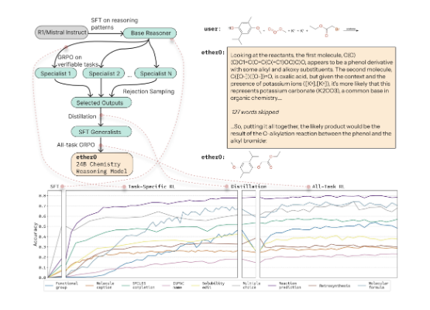
Phase 2: Supervised Fine-Tuning (SFT)
Goal: Learn to Answer Questions
•
Method: Training on (Prompt, Ideal Answer) pairs.
•
Data: A curated dataset of Q&A, instructions, and conversations.
•
Result: A "by-the-book" expert that answers questions it was trained on.

Slide 15
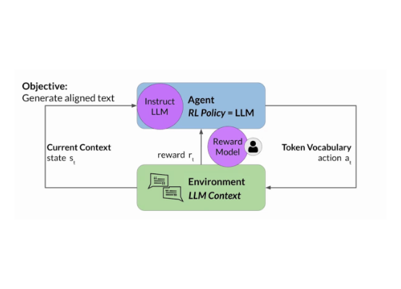
Phase 3: Reinforcement Learning (RLHF)
Goal: Learn "Preferences"
•
Method: A "Reward Model" (judge) scores the model's answers. The model is trained to get a high score.
•
Data: Human preferences (e.g., "Answer A is better than Answer B").
•
Result: An "aligned" assistant that gives helpful answers even to new questions.

Slide 16
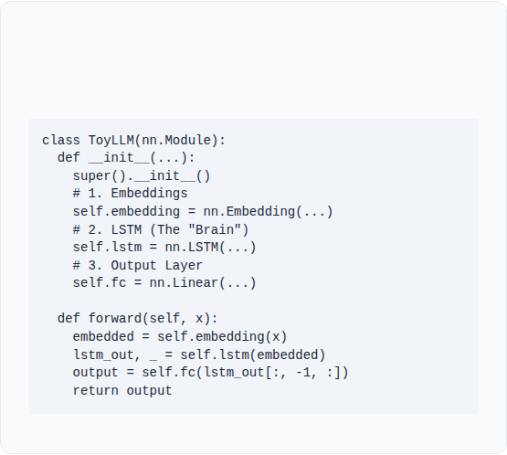
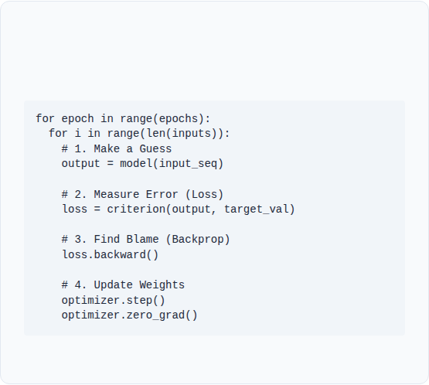
Connecting to Our Demo Code
The Model (ToyLLM)
The Training Loop (simulate_pretraining)
Our model uses the basic building blocks:
This is the "learning" process from Slide 7:

Slide 17
Key Takeaways
NLP is about turning words into numbers (Tokens, Embeddings) so a computer can learn from them.
Neural Networks learn by making guesses, measuring error (Loss), and updating their internal "weights" (Backpropagation).
Transformers use Self-Attention to understand deep context, outperforming older models like LSTMs.
Modern LLMs are built in phases: Pre-training (knowledge) -> SFT (skills) -> RLHF (alignment).

Slide 18
Questions?

Slide 19









Image Sources
https://smythos.com/wp-content/uploads/2024/11/human-brain-symbolic-ai-842x632.jpeg
Source: smythos.com
https://media.geeksforgeeks.org/wp-content/uploads/20240719175629/Input-Layer-in-an-ANN.webp
Source: www.geeksforgeeks.org
https://towardsdatascience.com/wp-content/uploads/2021/12/1hkYlTODpjJgo32DoCOWN5w.png
Source: towardsdatascience.com
https://api.wandb.ai/files/ayush-thakur/images/projects/103390/26bec8a6.png
Source: wandb.ai
https://media.geeksforgeeks.org/wp-content/uploads/20250523171309383561/recurrent_neural_network.webp
Source: www.geeksforgeeks.org
https://miro.medium.com/0*mxrHZpguNK-hfDrd
Source: medium.com

Slide 20







Image Sources
https://www.practicalai.io/wp-content/uploads/2023/02/encoder-decoder.png
Source: www.practicalai.io
https://miro.medium.com/1*pRuWa3mek-ubreFtja6YPQ.png
Source: python.plainenglish.io
https://miro.medium.com/1*jMVDYyKUWfzpdQ1Kx7FM_g.png
Source: medium.com
https://miro.medium.com/1*PK8BewZA0daezu-rZWm_Wg.png
Source: pub.towardsai.net

